Slide 1
Week 6 Update Team daea
Daniel Payan
Alex Brown
Evie Holyoake
Alex Farfan

Slide 2
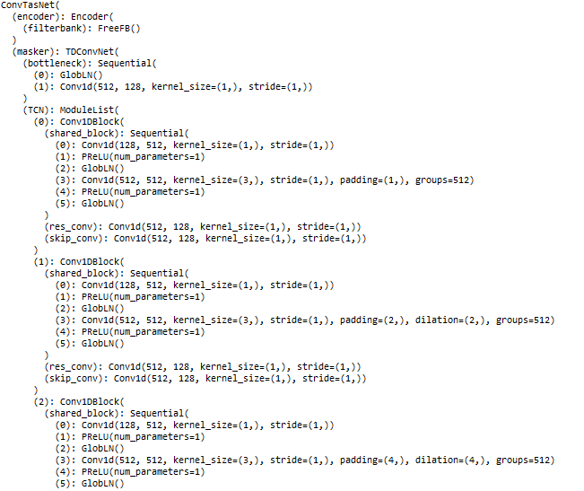
Alex Brown and Evie Holyoake
Current Progress
ConvTasNet Model
Asteroid Toolkit
MIT License
Separates two unknown speakers
Issues with separation of low vs high pitches
Low bleeds into high
Determine how much audio is needed to create an audio profile

Slide 3

Audio Separation Demo
Future Directions
Original Audio – Digitally Overlapped
Speaker specific models
Audio will go through n models that will separate a trained audio profile vs everything else
- or -
Unknown speaker models
Audio will go through one model built for a determined number of speakers
Multiple models will be built for each circumstance
First Stream
Second Stream

Slide 4
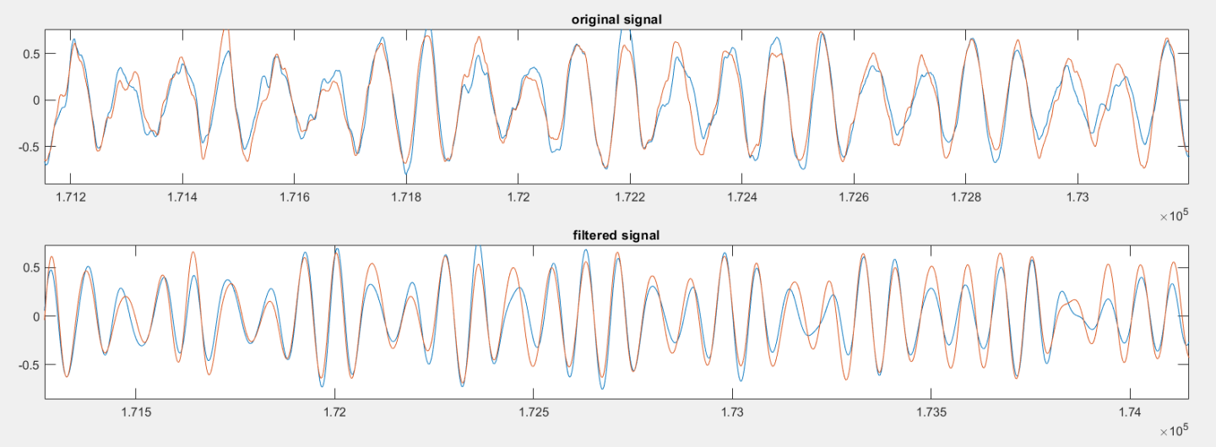
Alex Farfan and Daniel Payan
Meeting with Professor Kruger
Coral Board
Linux environment
Initial filter demo in MATLAB
Bandpass FIR filter
3 different types of filters
Continue other filter models

